Slide 1
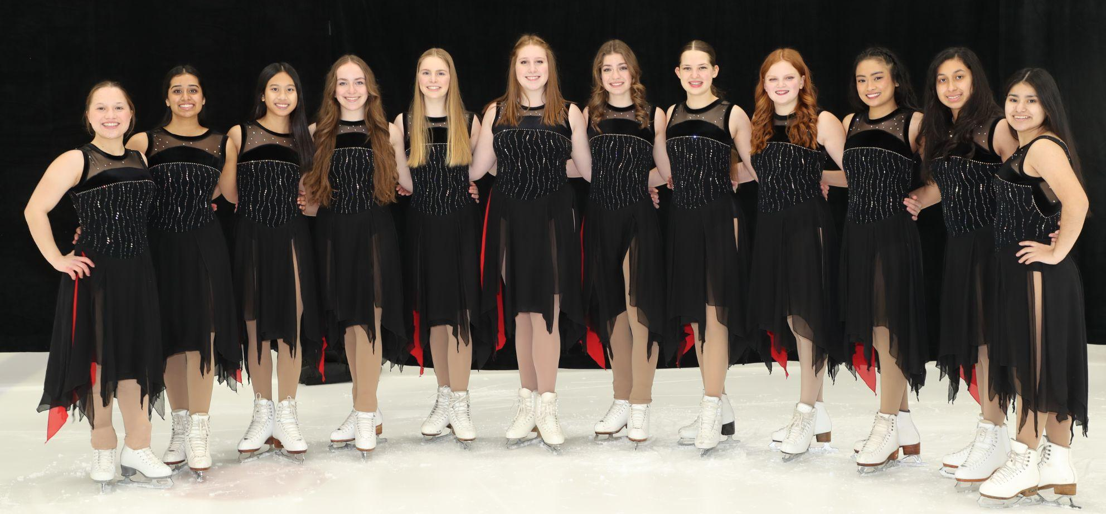
2023-2024 SEASON
Who we are
ICETTES Figure Skating Team is an ISD 196 club sport. Figure skaters at all levels (beginners too!) from Rosemount, Apple Valley, Eagan, Eastview, School of Environmental Studies High Schools and Middle Schools are part of the team.
Join us!
Tryouts week of 11/6/23
Varsity & JV FS (Free Skate- team compulsory, ensemble and single events)- required
Full team production- required
Varsity & JV synchronized skating teams -optional
Our Season
11/6-3/9/2024
Practice will be 2-4 times per week; Schedule will vary based on team placement
Typical practice schedule (subject to change): Mon- JV FS, Tues Varsity Synchro, Wed Varsity FS, Thurs JV Synchro, Fri- all team
Ice Show 3/6 (dress rehearsal), 3/7 & 3/8 7pm, 3/9/24 3pm (TBC)
Competitions
Frosty Blades 2/2-2/4/24- Blaine, MN
ISI Winter Classic 2/14-2/19/24 including travel days- *Orando, FL
Bold Ice Skating Challenge- Mpls, MN 3/1-3/2, 2024
Team Events
Halloween Party 10/28/23 6pm-9pm
Team Pictures @ 4:15pm before practice 11/14/23
Vertical Raise 11/17 4:30-5:30pm
Craft Sale 11/25/23 9am-4pm Rosemount Legion
Camp Sacajawea 12/2/23 2pm-8pm
National Wreaths across America 12/16/23 11:00am
Cub Bagging 12/17
Winter Team Building TBC
Team Banquet 3/17/24 5:30pm-8:30pm Royal Cliff
Memory book hand out 5/3/24 4-6pm
Support Shifts
We rely on parent/guardian support to provide the best skater experience. We need you.
Parent support shifts are required- Two (2) standard shifts and two (2) ice show shifts
Shift information will be shared via email and scheduled via signup genius
Fundraising
We rely on fundraising & donations to help reduce costs
Each skater is required to complete three (3) active fundraising credits (ex. Papa Murphy’s, Vertical Raise, Cub Bagging)
Passive fundraisers are also available (RaiseRight)
Please consider and share the need for donations & share potential sponsors to a board member
*Supporters are welcome but responsible for travel arrangements

Slide 2
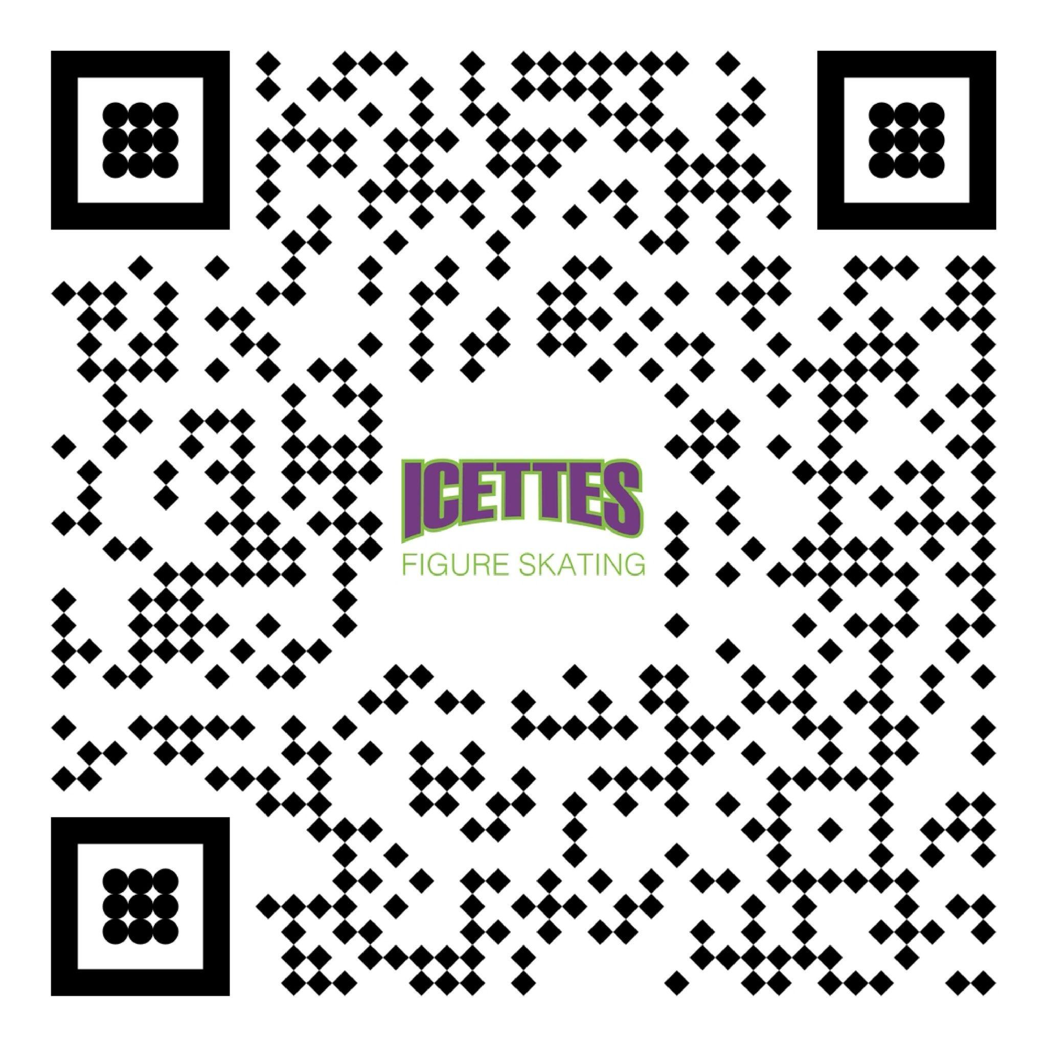
Costs
Sports Registration - due 11/6/23
MyPaymentsPlus $149-$176
Sports physical complete
ISI Membership- due 11/6/23
https://www.skateisi.org/membership/skaters/
$15 or $25 depending on term
Booster Club Fee- due 11/6/23
Payable via check , Zelle or credit card (3% processing fee)
$300 (includes competitions costs for synchro, team compulsory & production)
Required Uniform- due 11/6/23
Fabletics leggings, team backpack, ¼ zip pull over and t-shirt
Estimated cost $150
Winter Classic Trip Deposit due 11/6/23
$500
Winter Classic Trip Balance Due 12/6/23
To be confirmed. Estimated $1000
Optional Costs
Additional competitive events, spirit wear, blanket, outings, fundraising and parent/guardian shift buyouts
Booster Club Meetings (parents/guardians should attend)
Mon.. 11/6 6:00 pm Rosemount Community Center
Tues. 12/5 7:30pm Apple Valley HS Community Room
Tues. 1/9 7:30pm Apple Valley HS Community Room
Thurs. 2/26 7:30pm Apple Valley HS Community Room
Icettes Team Coaches
Karri Nachtigal
Brianna Regan
Icettes.coaches@district196.org
Booster Club Board Members
President: Millette Avenido, MD
Vice President: Jennifer Scott
Treasurer: Suzanne Rysavy
Secretary: Jennifer Nelson
Events Coordinator: Lisa Jones
Members at large: Thor Garness, LeeAnn Thomas
Icettes.booster.club@gmail.com
Visit Icettes.com to learn more
-request access for team only content
Join our closed group on Facebook
Enter skater information here:

